Slide 1
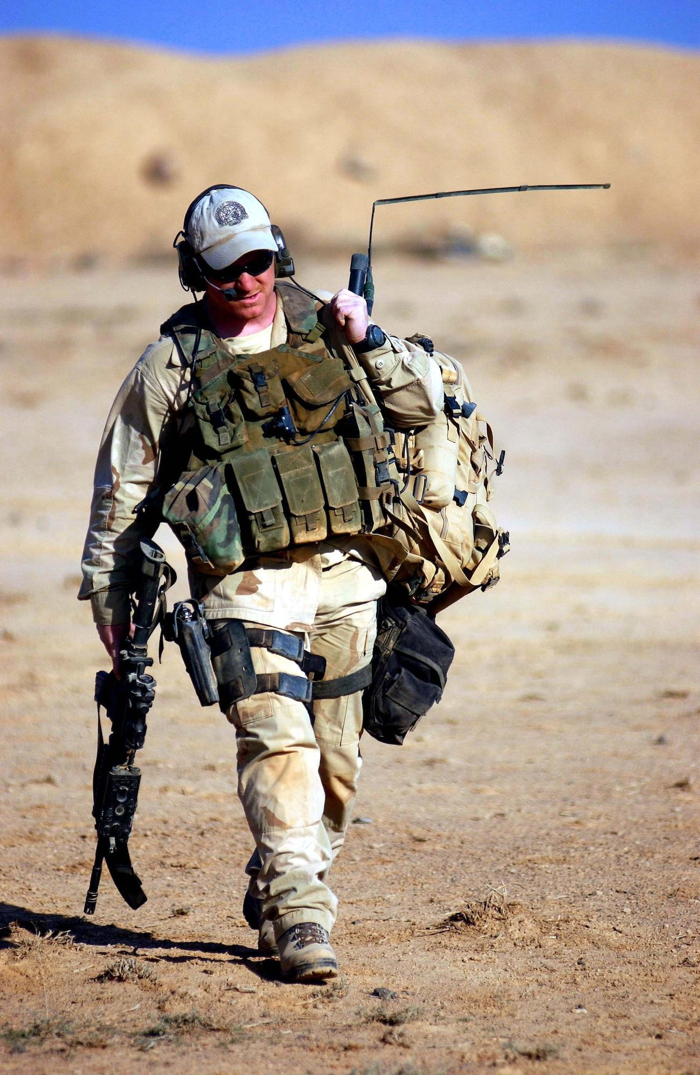
The Global War on Terrorism
The American Invasion of Afghanistan and Iraq
Developed for the Patriot Park Foundation
Hannah Walter, M.A., M.ED., 2026

Slide 2
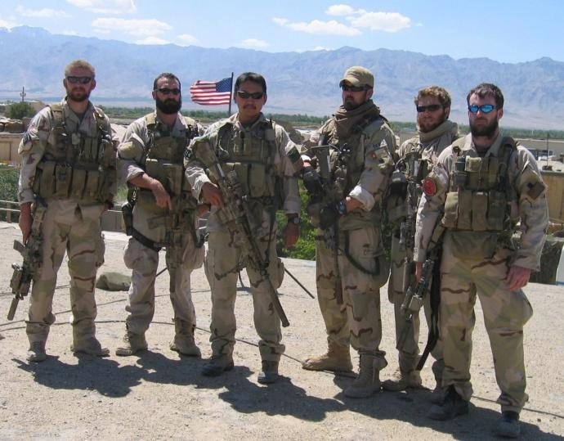
Essential Questions
Why did the United States and its allies invade in the Middle East?
What were the consequences of the War on Terrorism globally and domestically within the United States?

Slide 3
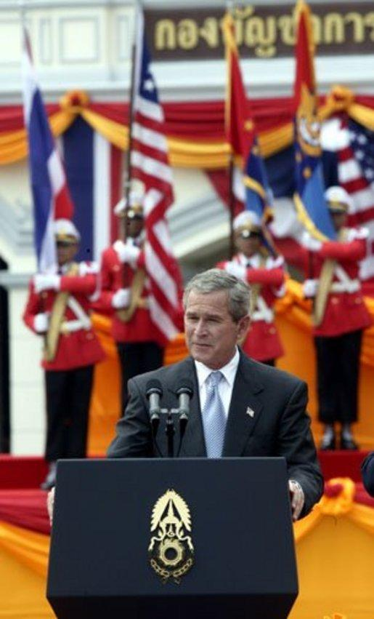
Warmup- Think Pair Share
Section 1
Take one minute to think about this quote by President George Bush (2001):
“Either you are with us, or you are with the terrorists.”
Now on an index card or piece of notebook paper answer these questions:
What does this statement mean?
What impact might it have internationally?
Why would some consider this statement controversial?
After answering the questions, share your responses and discuss them with a partner.
Notes:
*After students have shared and discussed with a partner take some volunteers to share their responses and discuss as a class.
Make note of themes that are recurrent on the board for students to see.

Slide 4
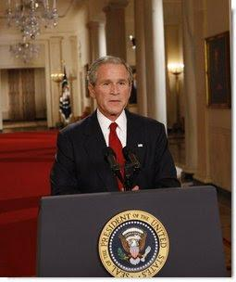
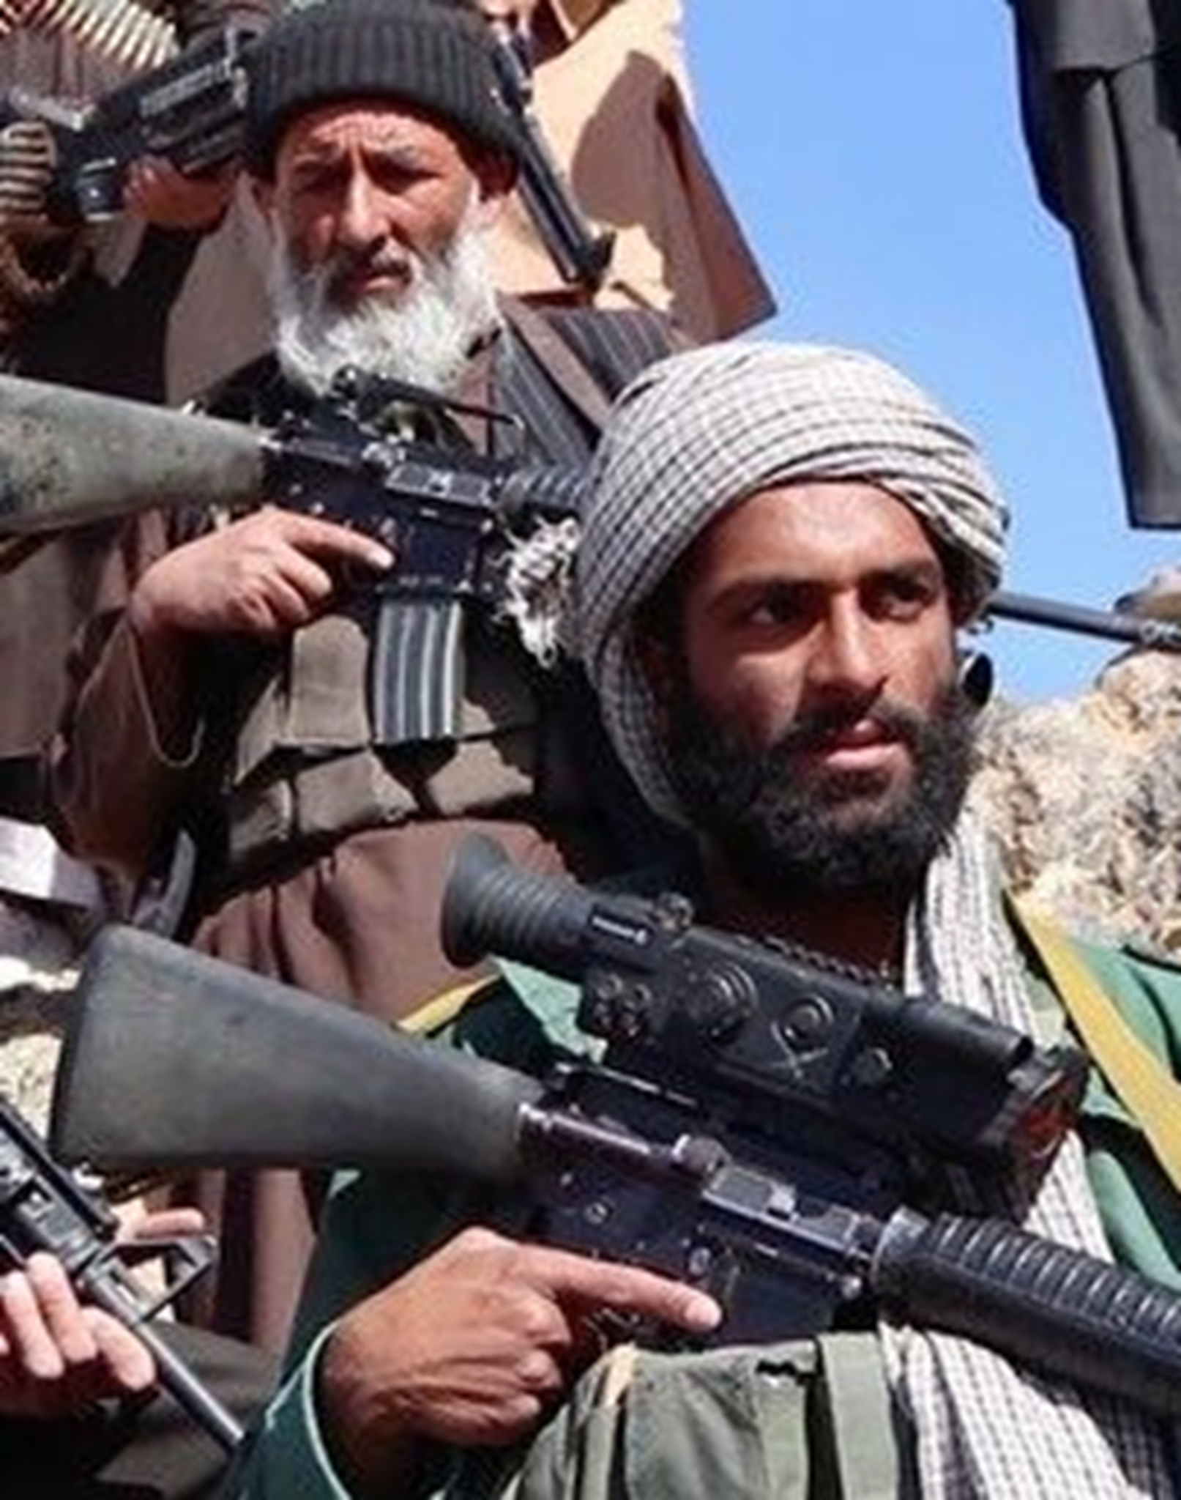
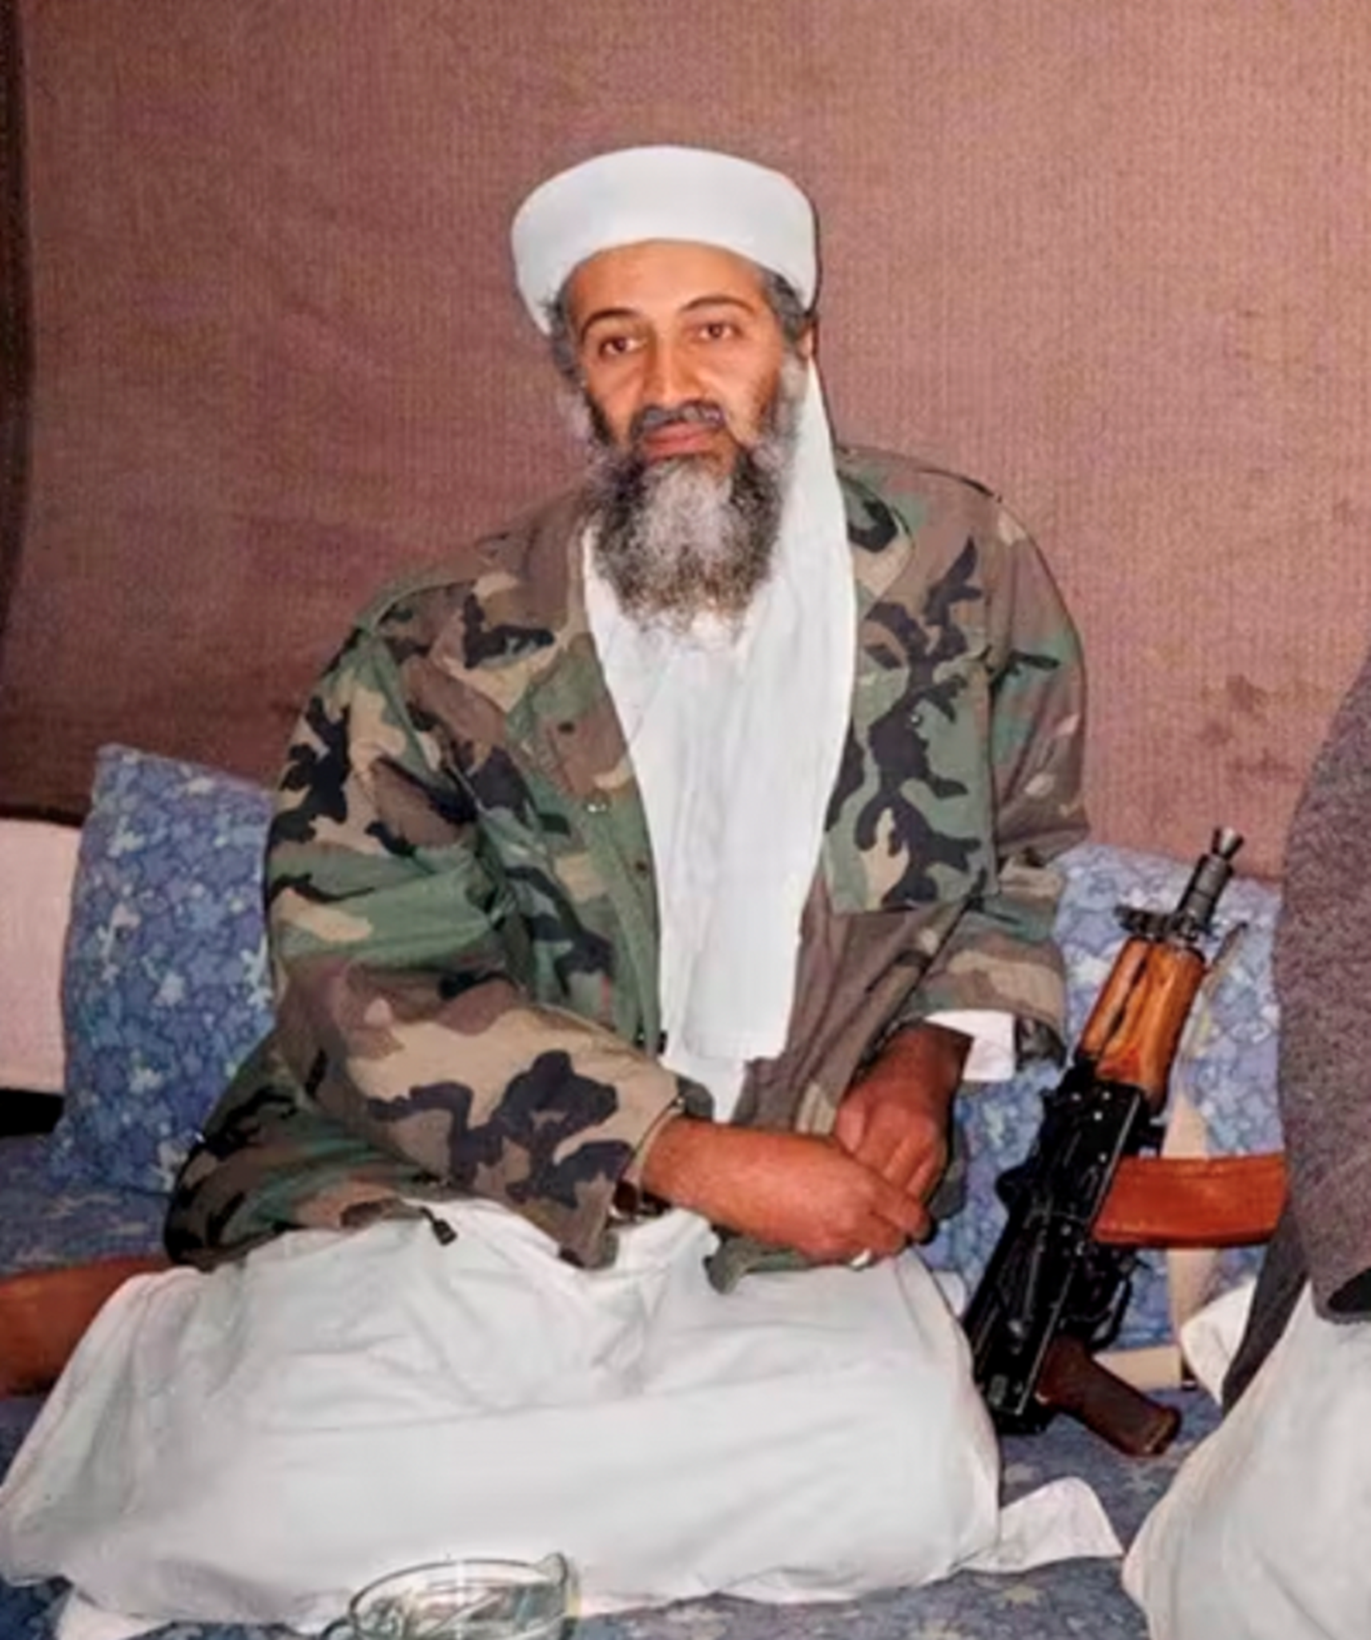
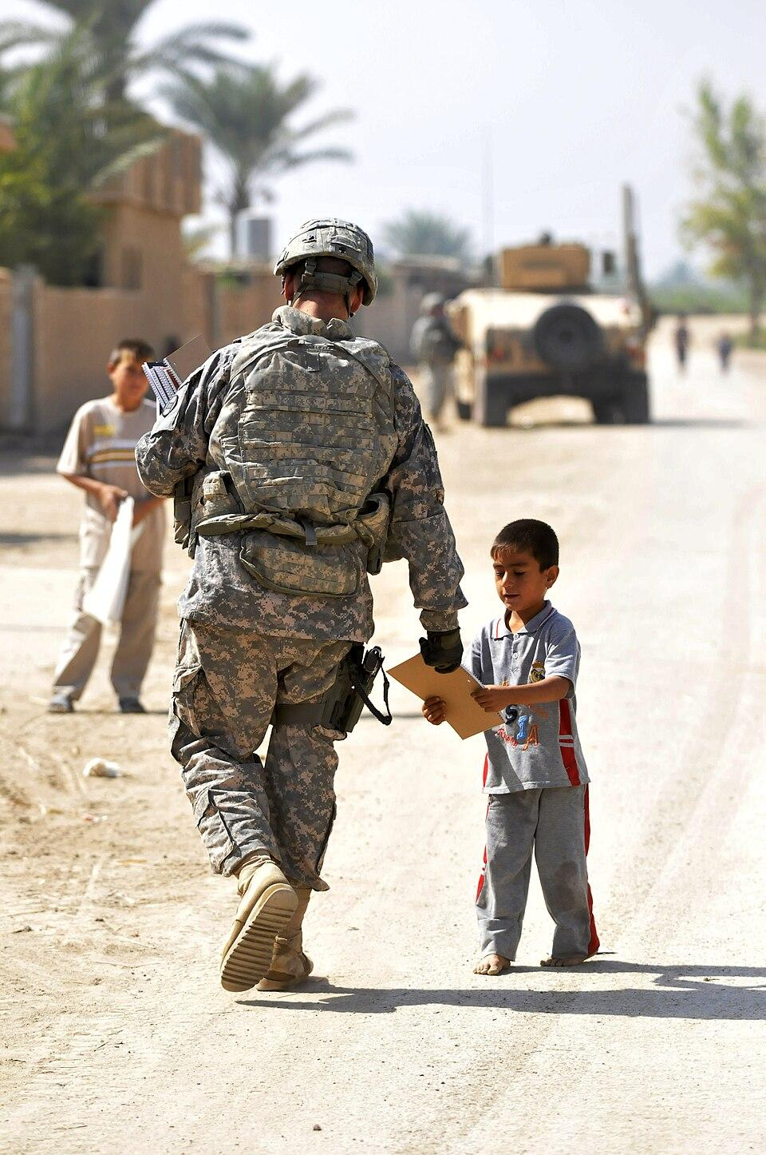
Key Figures and Terms
George W. Bush
Taliban
Al-Qaeda
Operation Enduring Freedom
Operation Iraqi Freedom
President of the U.S. from 2001-2009, during the Global War on Terrorism and the invasions of Iraq and Afghanistan.
A political party that ruled Afghanistan from 1996-2001 by using extreme religious views, laws, and violent punishments.
An international extremist group, led by Osama bin Laden. This group used a radical interpretation of Islam to justify terrorist attacks in the name of God.
The names of the two operations led by the American Military during the global war. These operations began with the invasions of Afghanistan and Iraq.

Slide 5
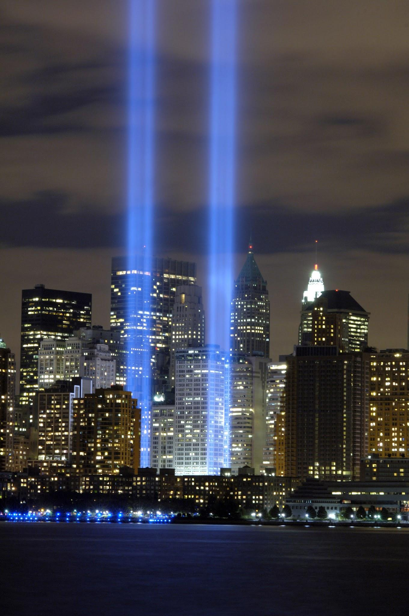
September 11, 2001
Understanding the 9/11 Attacks
What is terrorism? The use of violence against civilians to create fear and force political change.
Causes of the 9/11 attacks:
Islamic Extremism- Fundamentalist interpretation of Islam, often violent and oppressive in nature with strict laws and orders.
Constant political changes in the Middle East
Anti-American views due to the U.S. support of Israel
Immediate Responses:
Congress passed an Authorization for the Use of Military Force (AUMF), granting Pres. Bush executive powers to use military force against those responsible for the September 11th attacks.
Priorities: Finding those responsible for the attacks, locating Al-Qaeda bases in the Middle East.

Slide 6
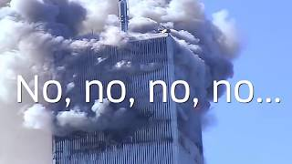
Timeline of September 11, 2001

Slide 7
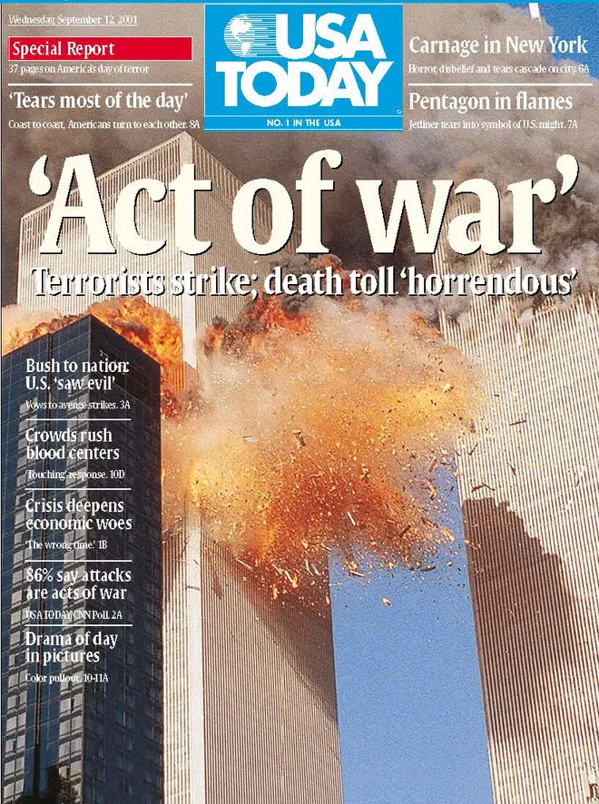
Headlines Activity 1
Examining this headline, what do you believe was the immediate American response to the 9/11 attacks by different groups?
The government?
The American people?
The media?
Provide your responses in your notebook.

Slide 8
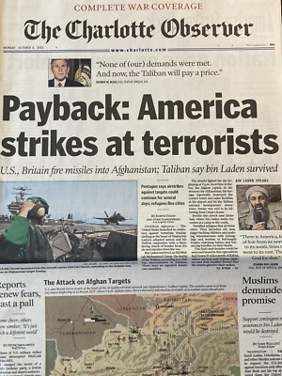
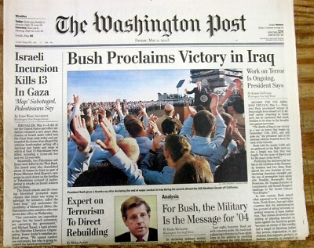
Headlines Activity 2
Examining these headlines, what do you believe was the American military response to the September 11th attacks?
Provide your response in your notebook.

Slide 9
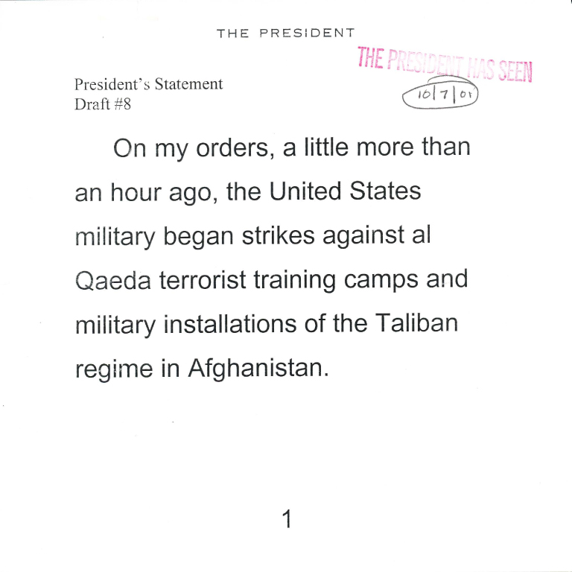
What is the “Global War on Terrorism”?
War on Terrorism
The Global War on Terrorism was the U.S.-led military, intelligence, and diplomatic efforts to combat terrorism after the 9/11 attacks.
Initiated by Pres. Bush in 2001 after the September 11th attacks.
This was not one single war in one place—It included multiple operations, alliances, and policies, especially in Afghanistan and Iraq.
This war has not officially ended, but strategies and objectives have shifted over time.
Answer this thinking question in your notes:
How do countries respond when they feel threatened, and what are the long-term costs of those responses?

Slide 10
Discussion Questions
Discussion 1
Please answer these questions in your notes:
What is an objective?
What is an outcome?
What are the differences between the two.
Talk with a partner about your thoughts and prepare to share your answers with the class for open discussion.

Slide 11
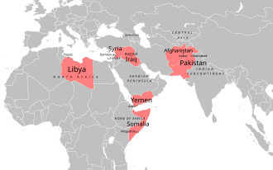
How was the War on Terrorism operated?
War on Terrorism
Objectives:
Use military force and invasion to destroy all terrorist strongholds in Asia and Africa.
This included training camps and the identifying which governments provided a safe haven for terrorist groups.
Key Events:
The Iraq War
War in Afghanistan
Syrian Civil War
ISIL Conflicts
Discussion Question: In what ways is the War on Terrorism different than previous wars America had fought?

Slide 12
Activity- Decision Making in Leadership
Goal- To understand the goals and evidence discussed by those in leadership and public policy.
Form small groups of three to four students, and then assign a role to each group member:
President of the U.S.- this member will serve as the leader of your group and should have the final say on all decisions.
Military Advisor- this member will consider all military positions first and advise the president based on this role.
Diplomat- this member should take a world view and think of the goals and consequences for international cooperation.
Civil Liberties Advocate- this member should think about the civil rights and liberties of all individuals when advising the president.
Scenario:
There has been a major attack on the U.S., one that has a significant impact on American society. Your goal as leadership is to ensure that there will not be another attack and to ensure national security. You do not have complete information as the situation is still evolving, but need a swift response to take action.
As a group, you must come to a concise agreement on the two actions that the country will take. You should discuss the actions from your assigned role, with the president making the final decision. Think about the positives and negatives of each action before making your final decisions.
Options for Action:
Invest in increasing intelligence efforts and surveillance internationally and in the U.S.
Launch attacks against suspected leaders of the attack.
Invade countries with governments that are hostile towards the U.S.
Gather countries to form an alliance focused on targeting future actions and providing aid to civilians affected by hostile groups.
Increase security efforts in the U.S. such as border security and international travel security.
Notes:
10-15 minutes
Discuss as a class once everyone has made their final decisions:
What did you prioritize when making your decision (security, diplomacy, speed, rights), and why?
What information would you want before making a real decision?

Slide 13
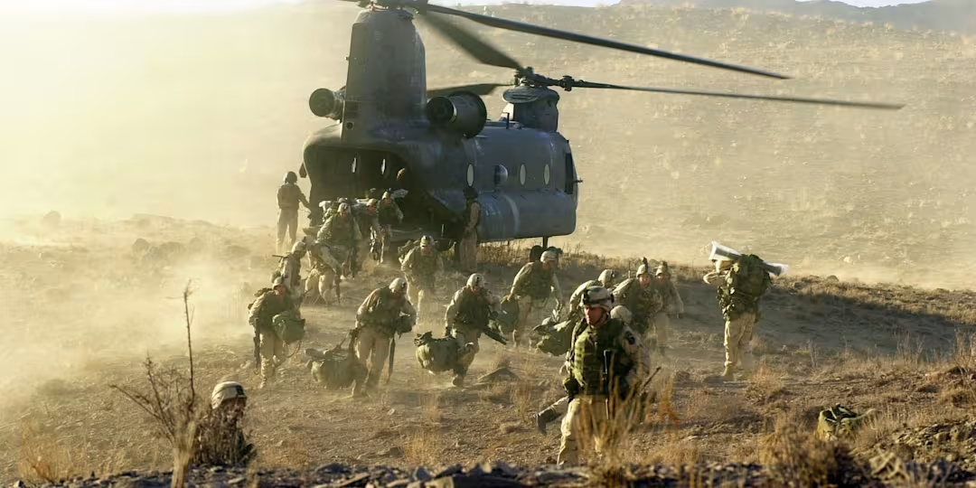
The Invasion of Afghanistan (2001)
Afghanistan
The government within the country (Taliban) were accused of harboring members of Al-Qaeda.
Goals for invasion:
Remove the Taliban from power
Disrupt al-Qaeda
Support a new Afghan government

Slide 14
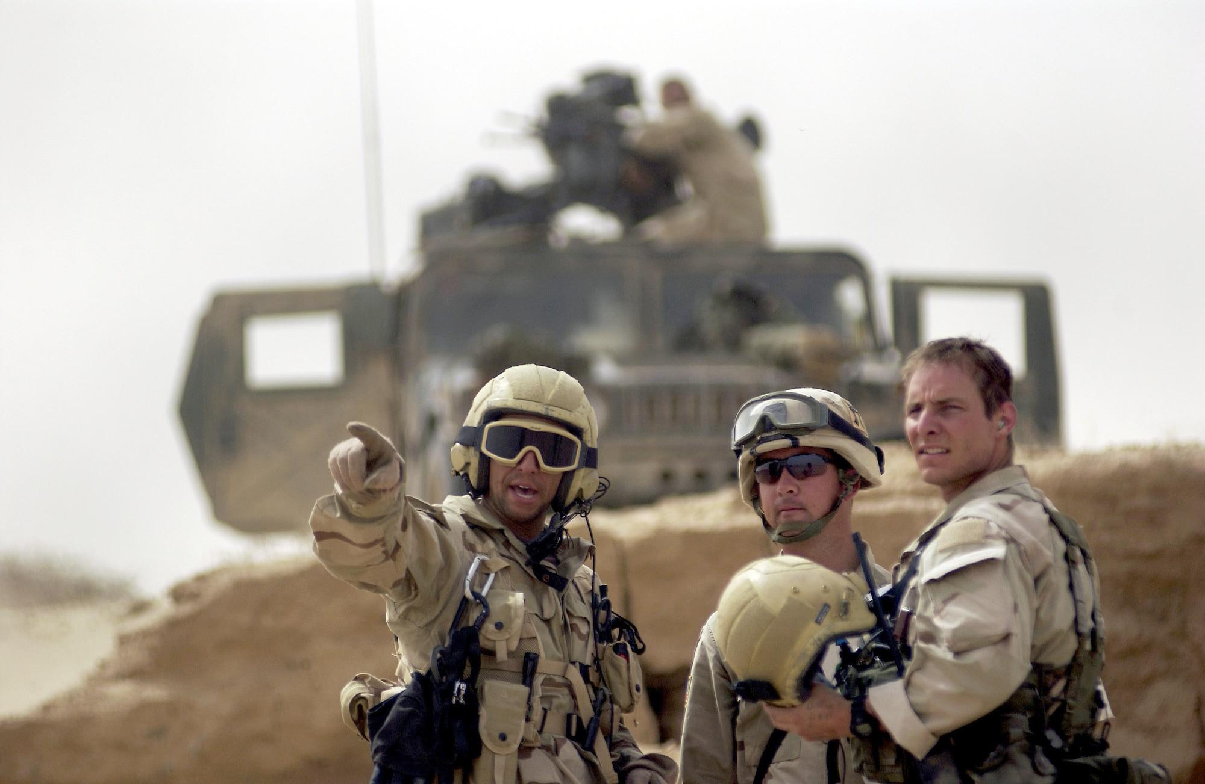
Invasion of Iraq
Iraq
Why did the U.S. invade?
Leaders argued over whether Iraq posed a major threat, including claims about weapons of mass destruction and needed to be disarmed.
What is a “weapon of mass destruction”?
Weapons that can cause large-scale loss of life (commonly nuclear, biological, or chemical).
Political Goal: Remove dictator Saddam Hussein and promote a new government.
Major controversy: The invasion was debated in the U.S. and around the world; many questioned the evidence and the plan for what would happen after.
Discussion Question: What responsibilities does a country have to another nation after it removes its government by force?

Slide 15
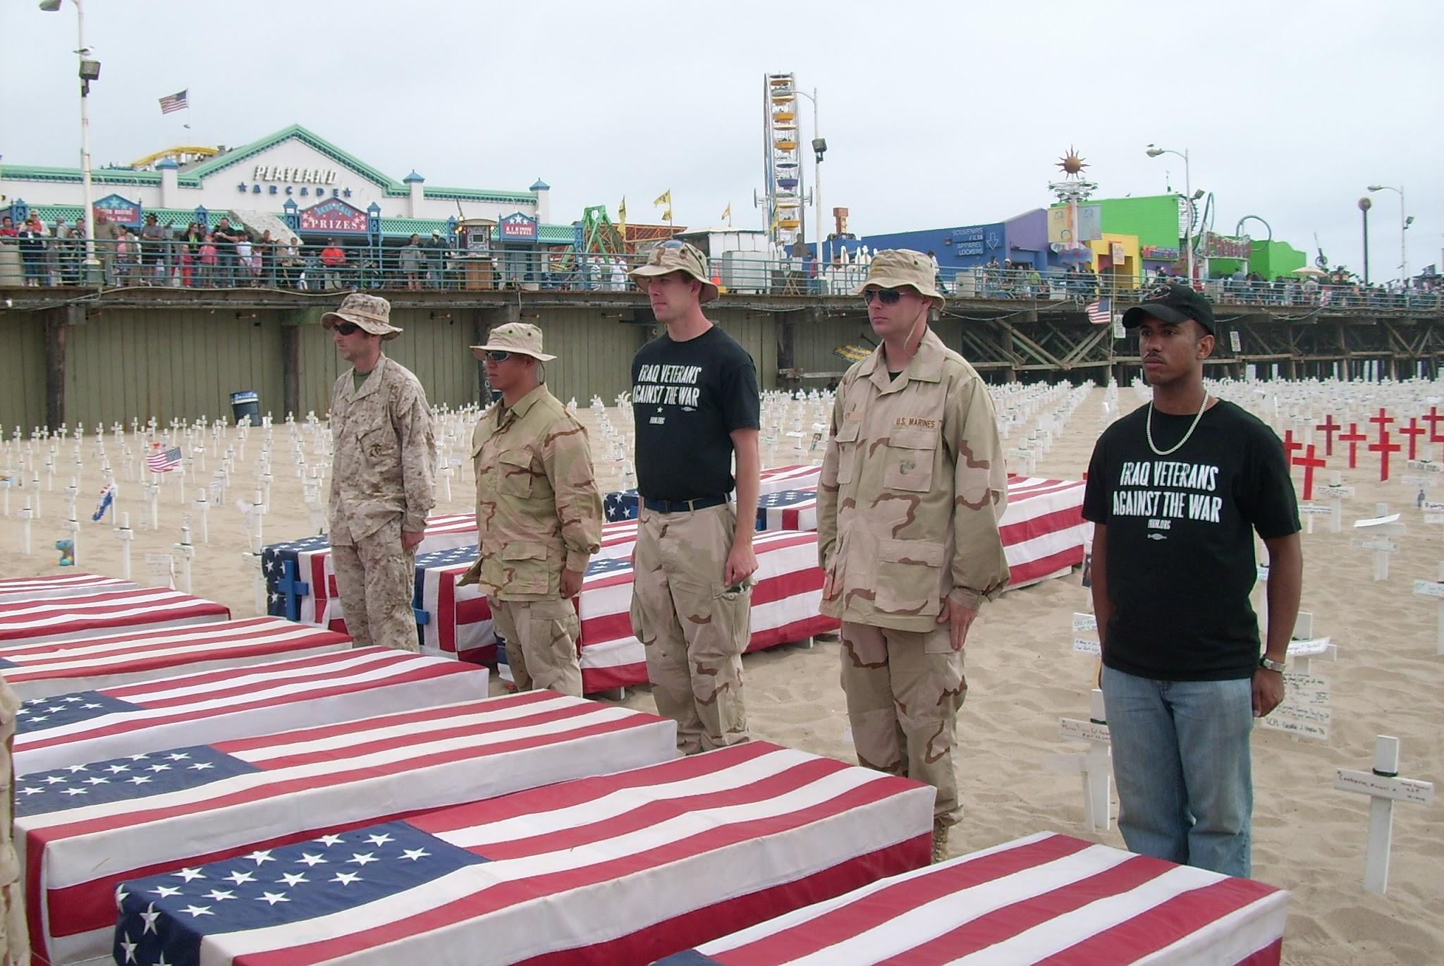
Fighting the War: Our Service Members
Service Members
All-volunteer military: Unlike earlier U.S. wars with a draft, most War on Terrorism service members volunteered.
National Guard and Reserves: Many were deployed, sometimes repeatedly, while also balancing civilian jobs and families.
Important Terms:
Deployment- Being sent to serve in a specific place for military operations.
Combat zone- An area where fighting is expected or ongoing.
Some service members served more than one deployment in combat zones, increasing stress and risk.
Discussion Question: How might repeated deployments affect a person’s life goals, family, or education?

Slide 16
The Realities of War
Fighting the War
This war is different from wars you might have already learned about, as there were not many traditional battles. Much time for soldiers involved patrols, guard duty, training local forces, and responding to emergencies.
Major dangers:
Improvised explosive devices (IEDs)
Ambushes and urban fighting
Unclear enemy lines (fighters blending into civilian areas)
IED (definition): A homemade bomb used to target military vehicles and patrols.
Human side: boredom, stress, fear, and strong bonds among units.
Discussion Question: Why might the mental stress of “not knowing when danger will happen” be especially difficult?
Discussion Question: Why might the mental stress of this form of warfare, of not knowing when danger will happen, be especially difficult for soldiers?

Slide 17
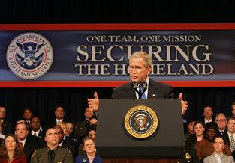
American Society
America at Home
Many changes occurred at home after the events of September 11th and the war:
Increased airport security and public safety measures were taken to address terrorist threats.
Debates grew over government surveillance, privacy rights, and security, particularly after the Patriot Act was passed.
Military families faced long separations.
Some communities had high numbers of deployments and losses.
Continuous war required major spending, which affected budgets and political debates on defense spending.
Discussion Question: In what ways can war impact those who never serve in the military?

Slide 18
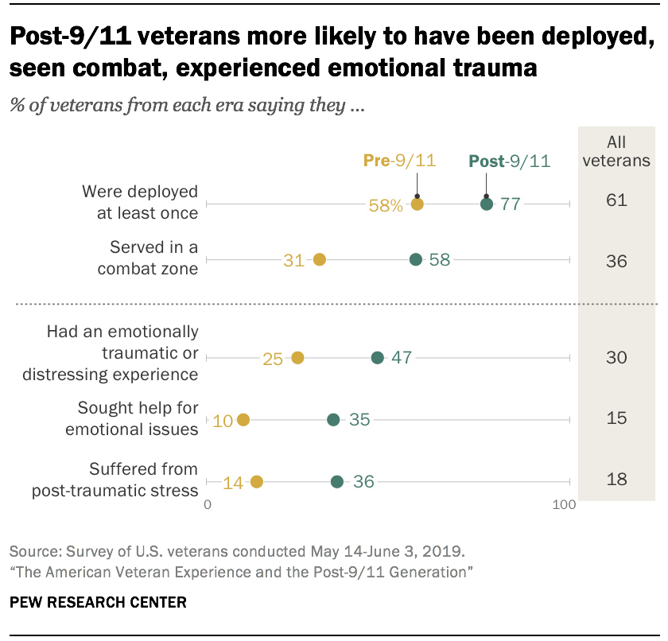
The Effects of the War on Veterans
Readjusting to life outside of war can be difficult to those that serve.
War causes disruption in lives, and individuals can face challenges in coming to terms with the violence experienced and witnessed.
Public acknowledgment of PTSD and other issues that arise from adjusting to life at home has increased since the War on Terrorism.
Many veterans reflect that their service during this era strengthened them personally, but significantly impacted their transition to civilian life.

Slide 19
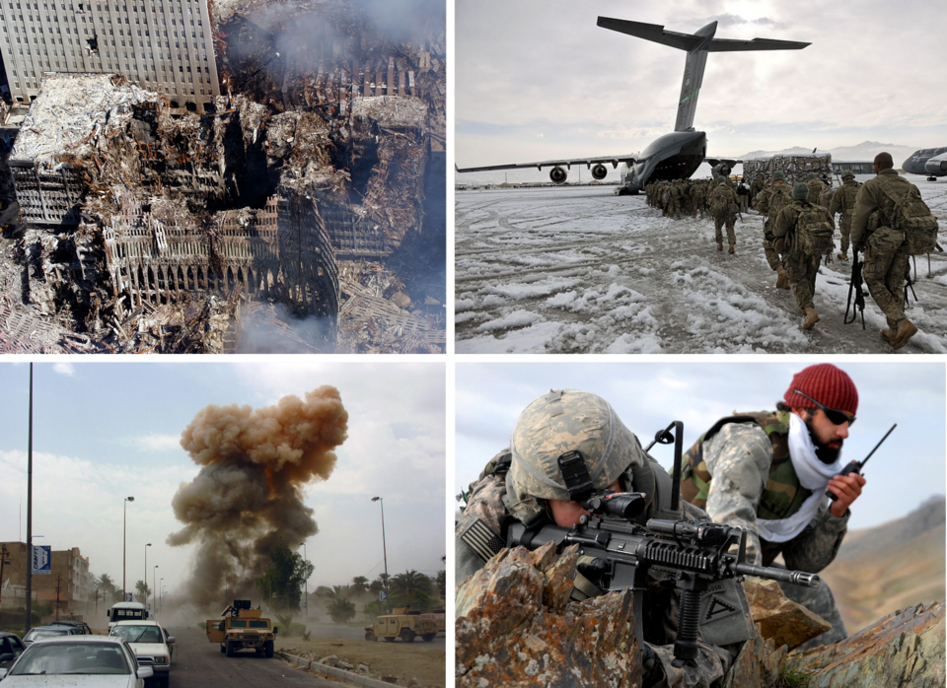
The Legacy of the War
Historic Legacy
What do historians debate about the war on terrorism?
What were the true costs of this war?
Can the goals of the war be distinguished from the outcomes and were they achieved?
How do you measure success in a war against terrorism and groups compared to countries and governments?
What can we learn as a society for the future?
The American departure from Afghanistan in August 2021 left a lasting debate of what the role of the U.S. should be in global affairs.

Slide 20
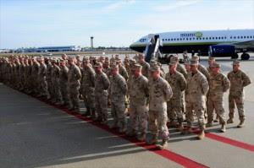
SUMMARY
1
After the terrorist attacks conducted by Al-Qaeda on September 11th, 2001 Congress passed an Authorization for the Use of Military Force (AUMF), granting Pres. Bush executive powers to use military force against those responsible for the September 11th attacks.
The priorities established by the U.S. were finding those responsible for the attacks and locating Al-Qaeda bases in the Middle East.
2
From there began the Global War on Terrorism, operated through several conflicts, primarily the conflicts in Iraq and Afghanistan. The warfare during this period, was different than other wars, seeking to eliminate terrorist groups and identifying the governments that were supporting them.
3
The Global War on Terrorism has left significant impacts on American society and its veterans. It has also created an enduring debate on the role of America in global affairs.

Slide 21

Exit Ticket Questions
On a separate piece of paper or a note card answer these two questions and turn them in to your teacher:
What changes occurred in American society as a result of the War on Terrorism?
In one sentence, what do you believe to be the trust lasting history of the War on Terrorism?

Slide 22
Bibliography
9/11 Memorial and Museum. "9/11 FAQs." National September 11 Memorial & Museum. Last
modified 2026. https://www.911memorial.org/911-faqs.
George W. Bush Library. "Global War on Terror." George W. Bush Library. Accessed
February 2, 2026. https://www.georgewbushlibrary.gov/research/topic-guides/global-war-terror.
Hartig, Hannah, and Carroll Doherty. "Two Decades Later, the Enduring Legacy of 9/11."
Pew Research Center. Last modified April 24, 2025. https://www.pewresearch.org/politics/2021/09/02/two-decades-later-the-enduring-legacy-of-9-11/.
History Channel Education. "Afghanistan War." HISTORY. Last modified April 15, 2025.
https://www.history.com/articles/afghanistan-war.
Library of Congress. "Global War on Terror: A Guide to First-Person Narratives in the
Veterans History Project." Research Guides at Library of Congress. Last modified April 30, 2025. https://guides.loc.gov/global-war-on-terror/impacts-of-the-experience.
Parker, Kim, Ruth Igielnik, Amanda Barroso, and Anthony Cilluffo. "The American Veteran
Experience and the Post-9/11 Generation." Pew Research Center. Last modified April 14, 2024. https://www.pewresearch.org/social-trends/2019/09/10/the-american-veteran-experience-and-the-post-9-11-generation/.
"President Declares "Freedom at War with Fear"." White House Archives. Last modified November 21, 2001.
https://georgewbush-whitehouse.archives.gov/news/releases/2001/09/20010920-8.html.
Schnurr, Kaloupek, Sayer, Weiss, Cohen, Galea, and Weaver. "Understanding the Impact of the Wars in Iraq and Afghanistan."
Journal of Traumatic Stress 23 (February 2010). https://www.ptsd.va.gov/professional/articles/article-pdf/id83684.pdf.
United States Congress. Public Law 107–40 107th Congress Joint Resolution To authorize the use of United States Armed Forces
against those responsible for the recent attacks launched against the United States. Congress, 2001. https://www.congress.gov/107/plaws/publ40/PLAW-107publ40.pdf.

